Slide 1
Lessons Learned Dust Emphasis Team Inspections On-Shift Examinations
By Roy Baker
District 4 Health Supervisor

Slide 2
Part 75 – 75.362 (a)(2) On-shift Examinations
Examination to assure compliance with respirable dust controls in the Approved Ventilation Plan
Within 1 hour of shift change if there is no break in production (Hot-Seating)
Prior to resuming production if there is a break in production at shift change
Deficiencies corrected prior to production beginning or resuming

Slide 3
Part 75 – 75.362 (a)(2) On-shift Examinations
Examination includes:
Air quantities and velocities
Water pressures & flow rate
Excessive leakage in water delivery system
Water spray number and orientation
Section ventilation & control device placement
Work practices in plan
Any other dust suppression measures

Slide 4
Part 75 – 75.362 (g)(2) On-shift Examinations
Certified person conducting the on-shift examination to assure compliance with the respirable dust control parameters was not certifying by initials, date, and time that the examination was made.

Slide 5
Water Spray System Examination
Sprays used were not approved in the plan
Water flow rate incorrect
Pressure was not being checked on both sides of the Continuous Miner and multiple locations on Longwall
Dirty sprays were producing an ineffective spray pattern

Slide 6
Scrubber Examination
Full Pitot Traverse checks of the scrubber were not being conducted and some folks did not know how to conduct the required checks or how to establish a centerline correlation factor (Average velocity divided by centerline reading) for use throughout the week for a comparison depending on your plan requirements.
Scrubber sprays were not being checked to make sure they were working and covering the entire area of the screen.
Different size screens were being used besides what the plan required. Examples- 20 mesh,30 mesh, or bottle brush type
Seals around screen doors and demister were missing or damaged.
The bottom of sumps were found clogged.
Deflector vents were damaged to keep from directing exhaust toward ribs and a few were found missing.

Slide 7
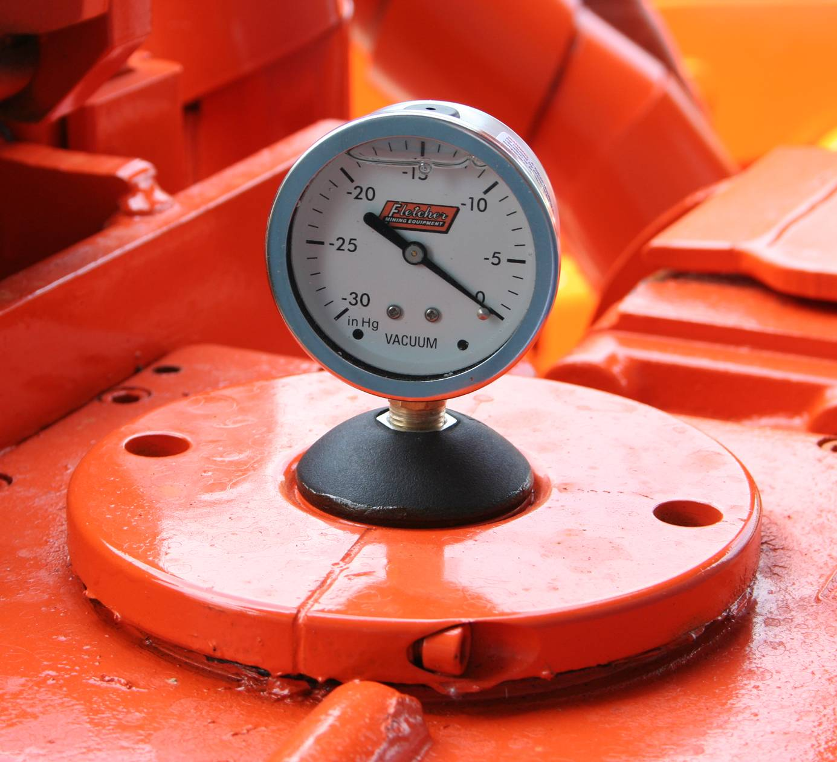
On-shift Parameter check of Roof Bolting Machines

Slide 8
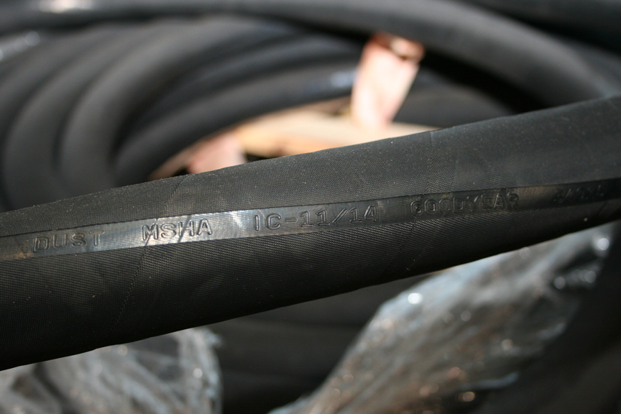
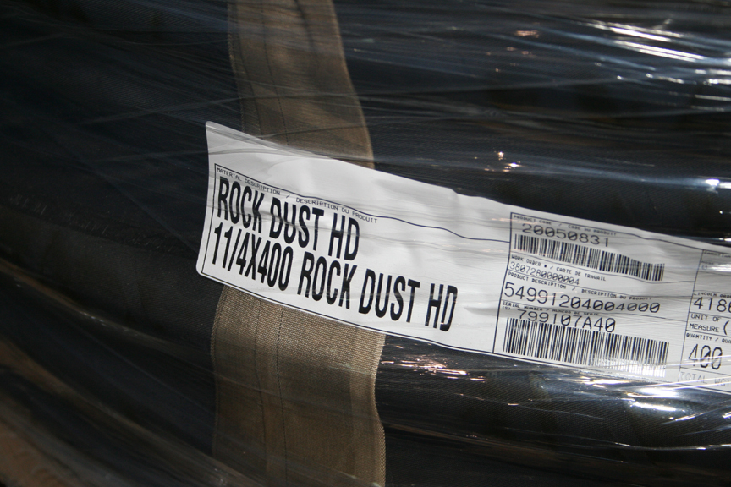
MSHA Approved Dust Hose

Slide 9
INSPECTION AND MAINTENANCE - DUST HOSE, FITTINGS AND CLAMPS
Check for and Fix Any Leaks
Check for Hose Wear and Replace if Required
Hose Clamps – Installed and Tight

Slide 10
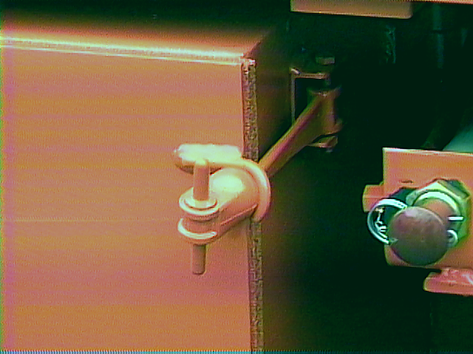
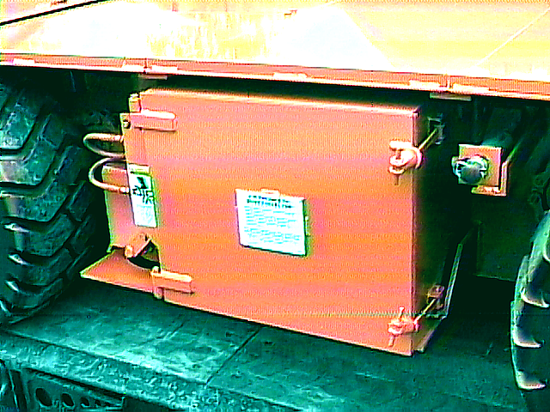
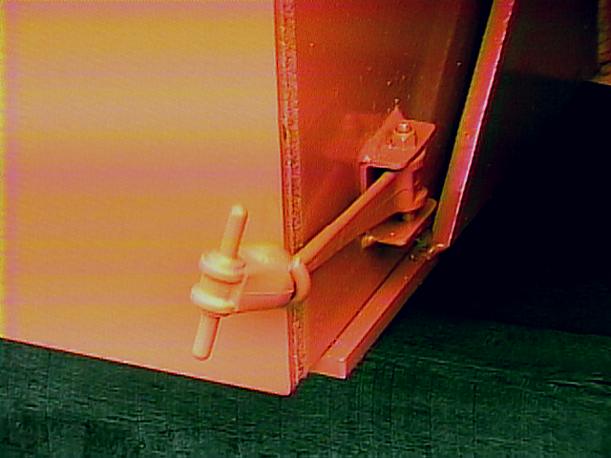
INSPECTION AND MAINTENANCE
DUST BOXES AND FILTER ELEMENTS...
Door Latches
If damaged replace with Fletcher OEM dust tank latch only.

Slide 11
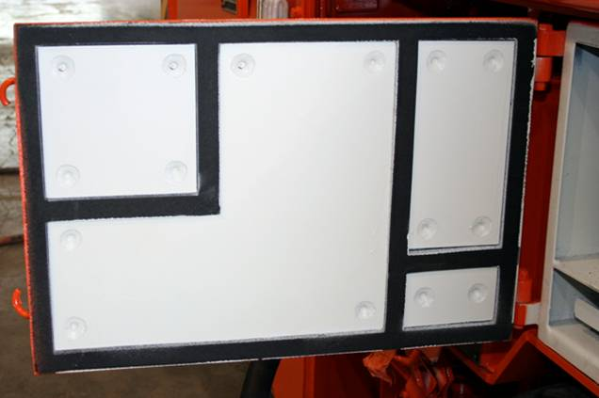
Doors
and Door Gaskets
Doors not warped or bent
All gaskets installed, in good condition and clean.
Each chamber must be separated. Check for air leaks and replace gasket if necessary.
Use only OEM gaskets

Slide 12
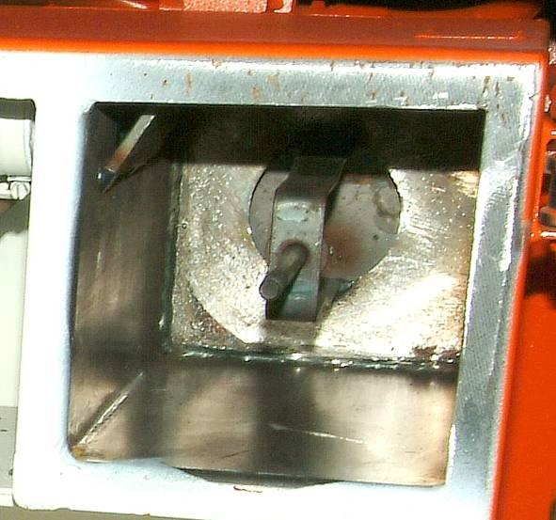
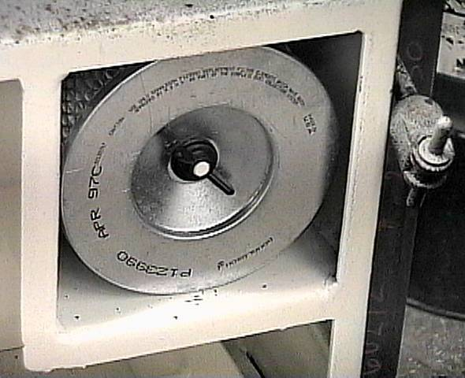
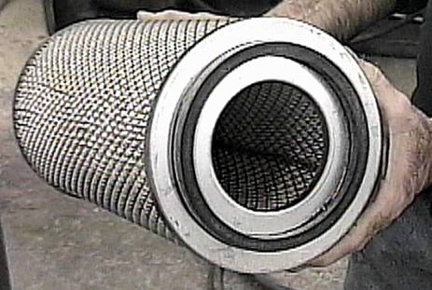
Filter Elements
Make sure filter sealing surface is clean
If dust bypasses filter, this cavity must be cleaned out or system will not operate properly.
Hand tighten wing nut as tight as possible
Dust leakage around nut is possible if not tight
Never attempt to clean filter elements.
Remove and properly dispose of dirty element.
Install new approved element when dust collection efficiency decreases to the point that drilling rate is reduced. Clean box area of dust before installing new clean filter or dust can contaminate clean side of system.

Slide 13
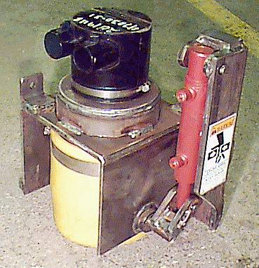
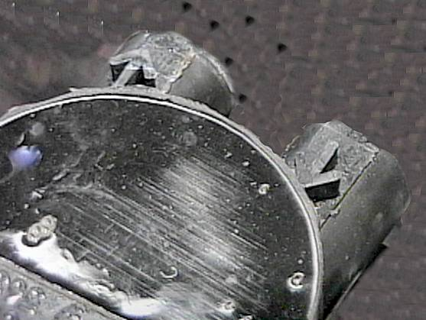
Cyclone Cap
PN: 56362
MAKE SURE HOSES ARE CONNECTED CORRECTLY
AIRFLOW DIRECTION ARROWS

Slide 14
Roy Baker
District 4
Mt. Hope WV.
PH# 304-877-3900
baker.roy@dol.gov

Slide 15
LESSONS LEARNED
DUST EMPHASIS TEAM INSPECTION FINDINGS
WATER DELIVERY SYSTEMS
DAVID STEFFEY
CLR – DISTRICT 5
NORTON, VA

Slide 16
FINDINGS OF THE DUST EMPHASIS TEAMS
Water delivery system problems found
Inadequate water pressure
Undersized pump
High resistance in pipe system
Inadequate water volume
Too small diameter water line
Poor water delivery to face equipment
Hose size
Piping on machine
Wrong sprays

Slide 17
FINDINGS OF THE DUST EMPHASIS TEAMS (cont.)
Water related Dust Controls Specified in Ventilation Plan are Ambiguous
Type of water sprays cover wide range of options – can not be evaluated
Specify BD-2, BD-3, BD-5 can be used
Spray flow rates 0.42 gpm to 1.6 gpm
Spray type 3
Spray XX or equivalent

Slide 18
FINDINGS OF THE DUST EMPHASIS TEAMS (cont.)
Water sprays
Required sprays not used
Lower water flow rate
Lower water pressure
Sprays are not maintained – dirty, do not produce spray pattern

Slide 19
Quickly Recognizing Problems Can Maintain Nozzle Performance, Quality and Efficiency
Seven Reasons Why Nozzles Don’t Perform Properly
Erosion and nozzle wear
Wear of the nozzle orifice and internal flow passages
As a result flow is usually increased, pressure may be decreased and the pattern may become irregular
Nozzles should be checked with a pressure gage and flow meter – when flow rate is 15% above published value this nozzle should be changed
Corrosion
Nozzle surface breaks down due to chemical action of sprayed material or environment
Nozzles that are corroded should be changed
Certain materials used to produce nozzles are more durable than others
Choose your nozzle based on in mine conditions
High temperature – Not usually a factor in coal mining

Slide 20
Caking or bearding
Build up of material on the orifice due to liquid evaporation
Water quality can greatly affect this (hard water)
Typically a problem with atomizing nozzles
Caked nozzles should be replaced
Damage
Damage to the orifice can occur when improper cleaning tools are used
Meaning – nails are not good for cleaning nozzles
Clogging
Material clogs the orifice and the spray pattern is not evenly distributed
Good filtration systems can help avoid this
Improper Assembly
Some nozzles require careful reassembly after cleaning
Simplicity of maintenance should be considered (the fewer the parts the better)

Slide 21
Considerations when Ensuring Water Delivery System Meets Plan Requirements
SOURCE OF THE MINE WATER
Public
Water storage tank
Surface water – pond/stream
FILTRATION TO MAINTAIN A CLEAN WATER SUPPLY
At source
On MMU
Maintain filtration system

Slide 22
Other Considerations
Number and Type of MMU’s you will use
Continuous Miner
Dust suppression sprays
Scrubber
Wethead Miner
Longwall
Other Water Needs
Belt transfer points
Regulatory requirements for fire fighting

Slide 23
DAVID STEFFEY
CLR – DISTRICT 5
NORTON, VA
Steffey.David@dol.gov

Slide 24
Lessons Learned Dust Inspections
By Brent Wolfe
Health Specialist
District 3

Slide 25
Operator Sampling Program
Sampling Unit
Equipment (sampling units) not maintained as approved
Flow rates not maintained at 2.0 L.P.M.
Sampling head assemblies are not cleaned and inspected
Pre-sampling shift checks :
Black hose used
No voltage checks made
Pump and apparatus assembled prior to 3 hours before the start of the start of shift
Sampling Procedures
Respirable dust samples are not collected at required times (shifts/days)
Example : 14 days to take 5 valid samples with full production, 3 shifts a day.

Slide 26
Operator Sampling Program
Sampling Procedures
Certified persons do not know the regulatory requirements for the proper collection of respirable dust samples
A Control Filter sent in as a Regular Sample
1 Control Sample sent in for 5 separate respirable dust samples
Improper record keeping for length of shift
Maintaining sample in appropriate location:
Belt DA Sample found too far away
Operating sampling unit portal-to-portal
Full Shift Sampling

Slide 27
Air Quantity
Air at end of curtain does not match plan
Example: Lower air quantity due to curtain found 16” off the mine floor.
Air not balanced with scrubber quantity (blowing face)
Example: To much air quantity at end of line curtain (More than limits of Plan).

Slide 28
Dust Scrubber
Scrubber quantity lower than plan quantity
Air quantity measurements performed incorrectly
Plugs in Pitot holes
Not testing all Pitot holes
Holes between scrubber screen sprays and screen

Slide 29
Dust Scrubber
Ductwork dirty/plugged
Screens not dried per Plan
Demisters found with 1 inch thick sediment on layer filaments
Sump pump not working

Slide 30
Roof Bolter Dust Collectors
Dust box door seals not maintained - Non-approved seals
Ex. weather stripping from home improvement store
Vacuum hoses do not match approval requirements and found leaking
“Clean“ side of collector contaminated
Dust box door latches not maintained
Vacuum setting does not meet approval plate

Slide 31
Roof Bolter Dust Collectors
Non-Approved Hoses being used ( electrical conduit)
Electrical tape covering up holes
Clean Side of system contaminated with white fine dust
Latches missing; Door hinges broke; Mine sealant used to seal door.
Vacuum pressures to low, Hoses not clamped onto barbed connector’s.

Slide 32
Roof Bolter Dust Collectors
Valves installed in the dust collection system.
Low pressure found when valve to dust collection box turned off.
Door Seals “pieced” together with and without approved seals.

Slide 33
Dust Controls not being Maintained According to Approved Ventilation Plan
Water sprays
Required sprays not used (1MM sprays used instead of 3/32”)
Lower water pressure (dirty filters, inside of hoses collapsed).
Sprays not maintained—dirty, do not produce spray pattern.

Slide 34
Dust Controls not being Maintained According to Approved Ventilation Plan
Mag Gauges not maintained
Holes on adapters of Mag Gauges plugged with dirt/sediment
Loose adapters on Mag Gauges
CMO’s do not know Plan requirements (Scrubber screen needs cleaned every 40 feet of advancement).

